Slide 1
Data Analytics Approach:
Sprocket Central Pty Ltd’s
High Value Customer
Muhammad Al Reza Fahlopy Dharma
Data Analytics Approach Consulting Virtual Intern

Slide 2
Agenda
Introduction & Bussiness Statment
Data Exploration & Interpretation
Model Development & Interpretation

Slide 3
Business Statement
Business Statement :
The marketing team want to boost business by analyze their customer dataset for find the trends and behaviour. After that , marketing team will identify and recommend TOP 1000 Customer to target by trend and behaviour from CustomerDemographic.

Slide 4
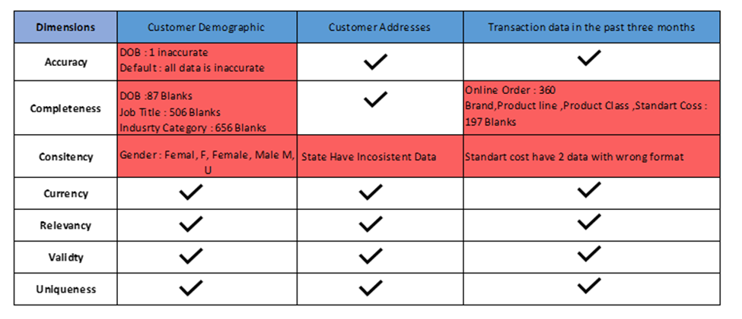
Data Quality Assesment

Slide 5
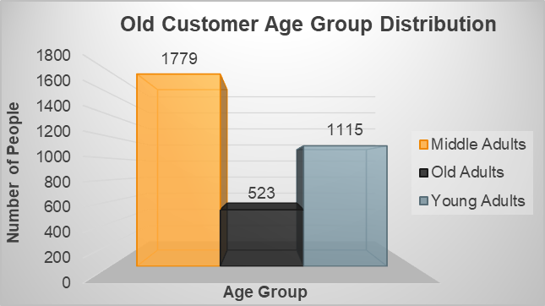
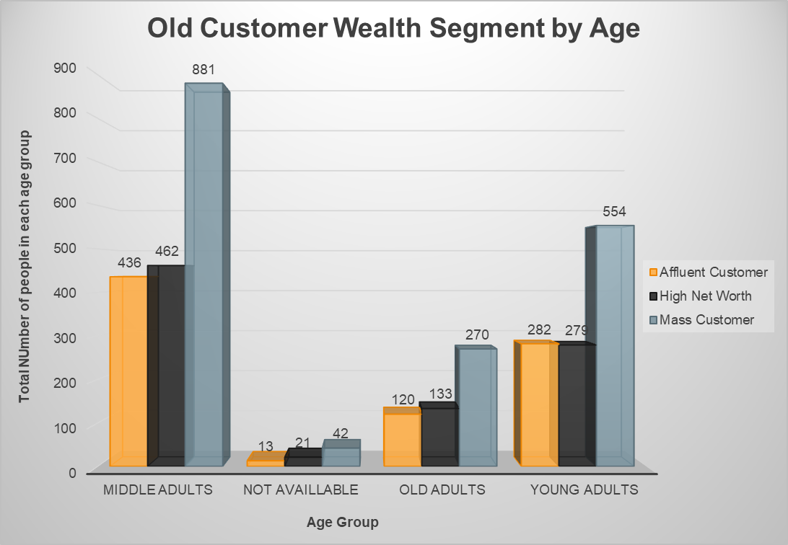
Data Exploration
Old Customer Age Distributions & Old Customer Wealth Segment by Age Group:
Most of the distribution of Old customers with the middle age group adults. Then mass customer has the highest count in every age group.
The age group with the lowest distribution is Old Customers (59 – 100).
In old Customer Distribution, the most stable age group is the middle adult age group.

Slide 6
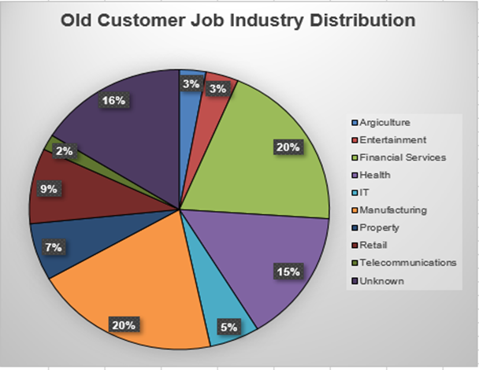
Data Exploration
Old Customer Job Industry Distributions :
20% of Job Industry from New and Old Customers are in the Manufacturing and Financial Services industry. The job industry is the industry with the largest distribution.
Job industries with small distribution figures are in the agriculture and telecommunications industries with percentages of 3% and 2%.

Slide 7
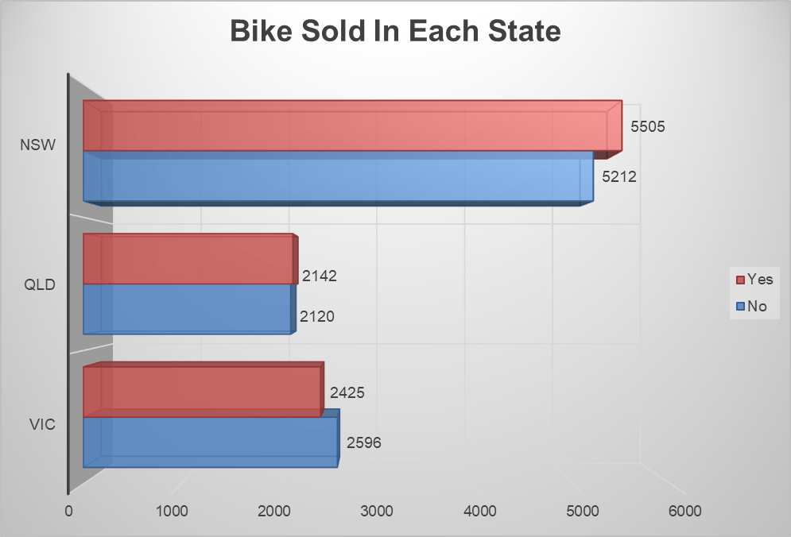
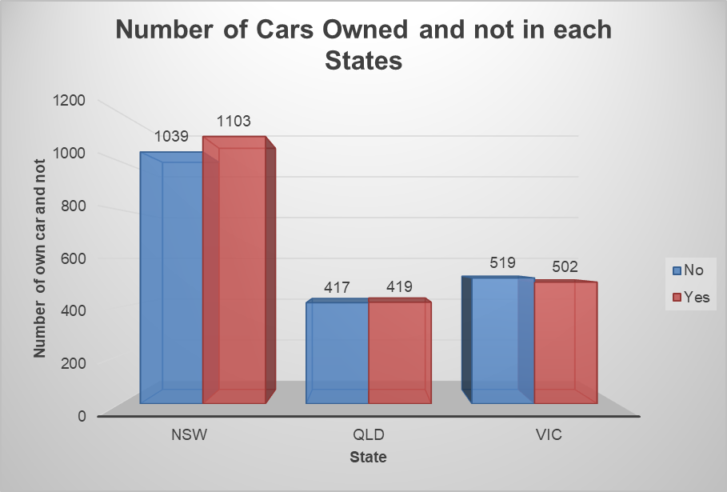
Data Exploration
Number of Cars Owned and Not in Each States & Number of Bike Sold in Each States:
As we can see, New South Wales has the most clients, followed by Victoria, and so on. When we look at the number of bikes sold in each state, we see that the state with the most customers also has the most bike transactions. The number of customers, either owned or not owned car does have similar power buying.

Slide 8
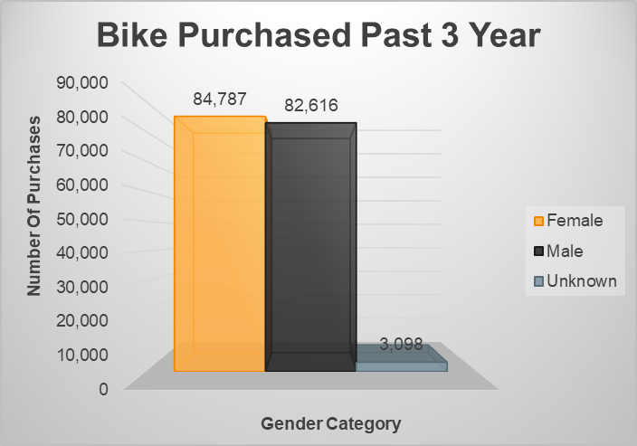
Data Exploration
Bike related purchases over last 3 year by gender :
From the last 3 years, the highest number of bicycle purchases based on gender were women, second by men and third by unknown gender.
The number of purchases from women managed to exceed the number of purchases made by men. Numerically, the purchases made by women in the last 3 years amounted to 84,787 bicycles, while only 82,616 for men.
That way, in the last 3 years, women have bought more bicycles than men with a purchase difference of 2,171.

Slide 9





Based on the results of our analysis we are targeting customers with the following criteria
Age Group
of the three age group categories, the middle adult category is the category that has the most distribution.
Segmentation
most customer come from mass customer.
Job Industry
56% Customer work on manufacturing, financial services, and health sectors.
Location
Most Customers or client live in New Sout Wales (>50%).
Gender
Women and men have nearly the same purchasing power.

